Slide 1
Web Service
(SOAP)
nagen@synergisticit.com

Slide 2



What is SOAP

Slide 3
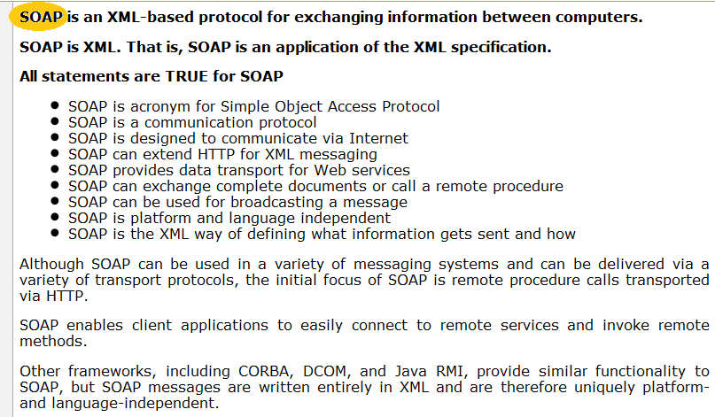
What is SOAP

Slide 4
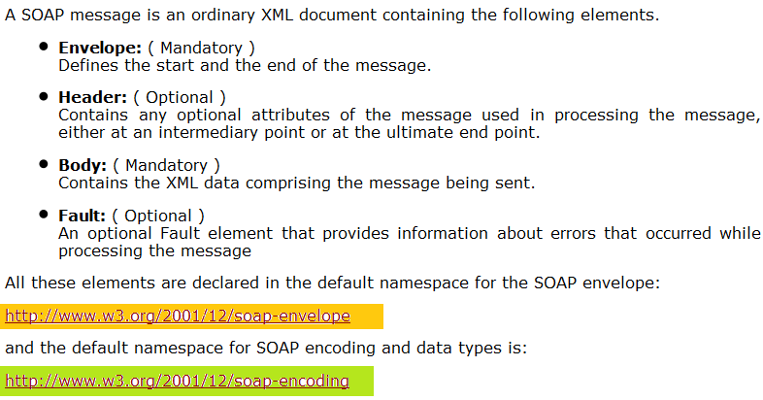
SOAP Message Structure

Slide 5
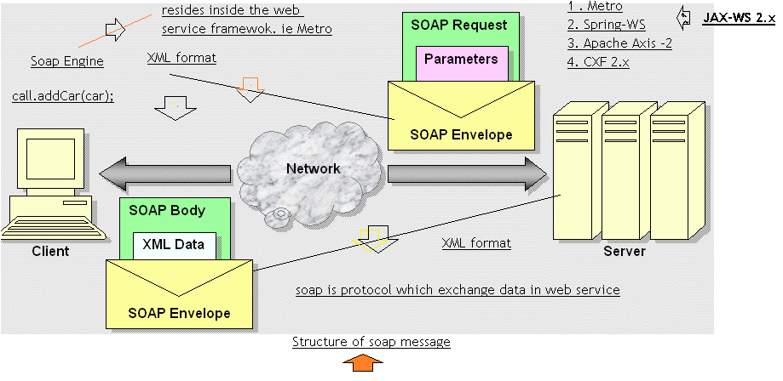

Slide 6
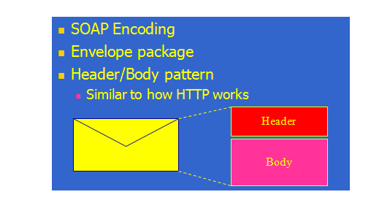
SOAP Message Structure

Slide 7
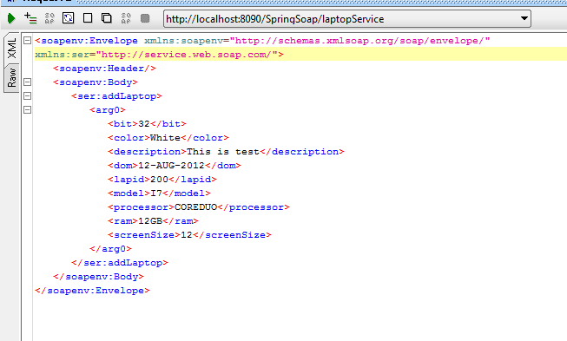
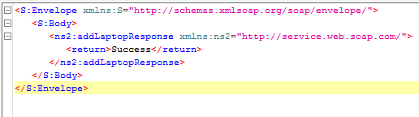
Soap Request and Response

Slide 8
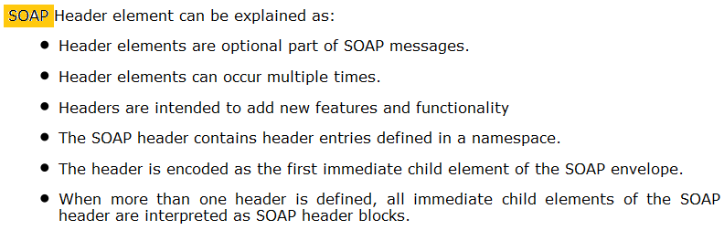
SOAP Header Element
The optional Header element offers a flexible framework for specifying additional application-level requirements. For example, the Header element can be used to specify a digital signature for password-protected services; likewise, it can be used to specify an account number for pay-per-use SOAP services.

Slide 9
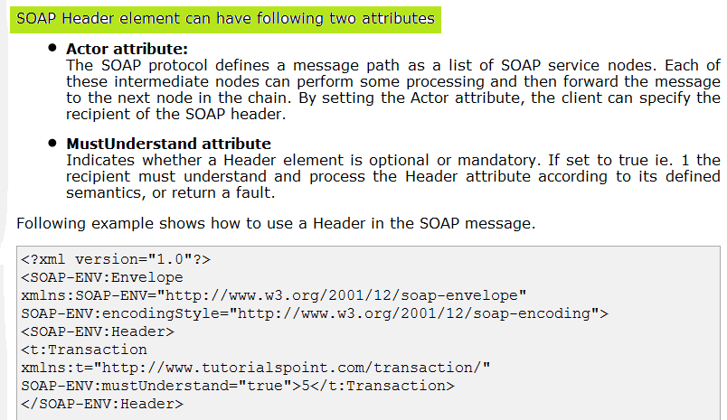
SOAP Header Element

Slide 10
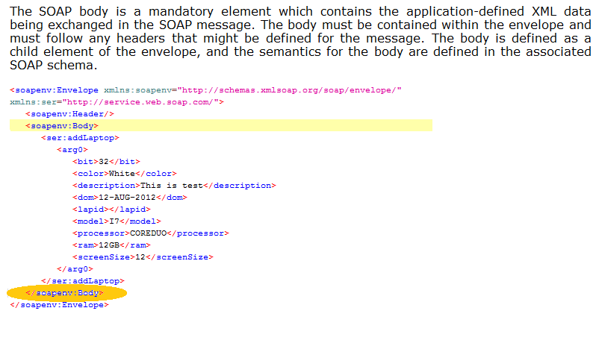
SOAP Body Element

Slide 11
SOAP Fault
SOAP Fault messages are the mechanism by which SOAP applications report errors to node earlier in the message path.
SOAP Faults are generated by receivers , either an intermediary or the ultimate receiver of the message.
The receiver is required to send SOAP fault back to the sender only if the Request/Response messaging mode is used.
SOAP message that contains a Fault element in the body is called a Fault message. A fault message is analogous to Java Exception

Slide 12
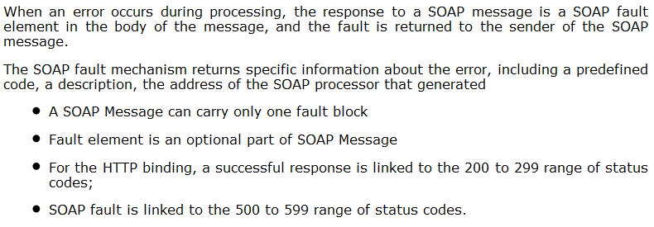
SOAP Fault Element

Slide 13
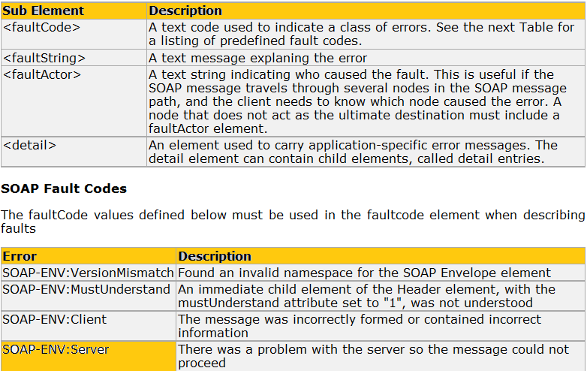
SOAP Fault Element

Slide 14
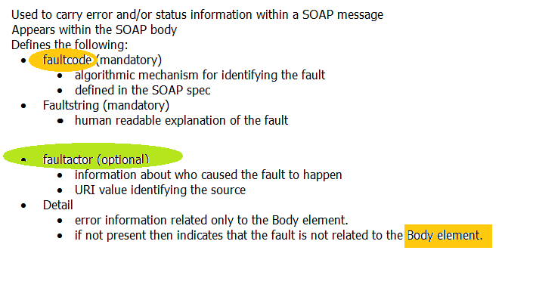
SOAP Fault Element

Slide 15
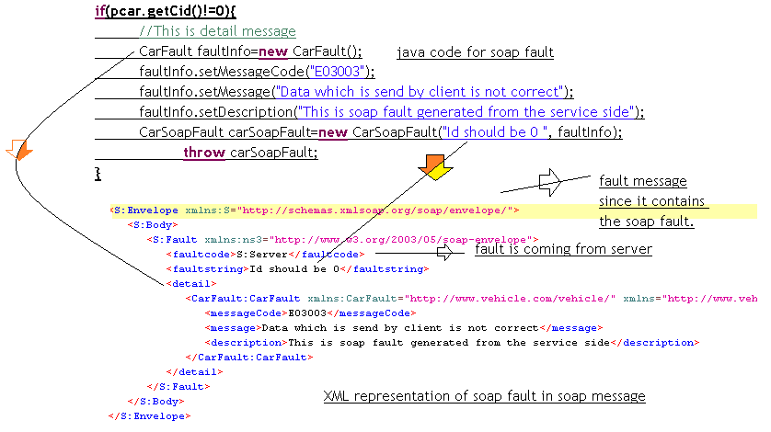

Slide 16
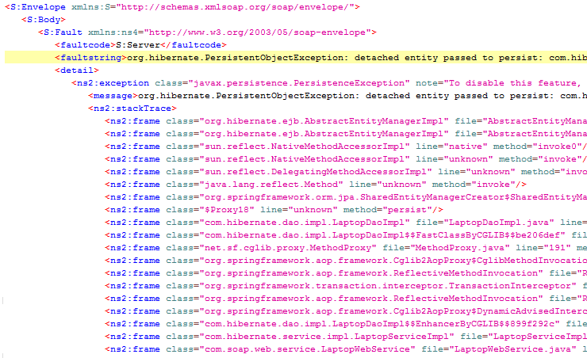
SOAP Fault Element

Slide 17
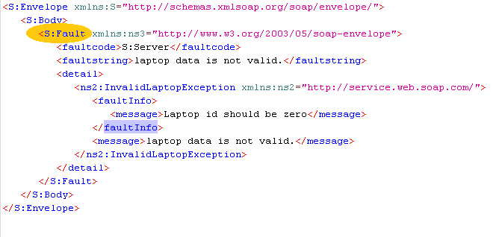

Slide 18
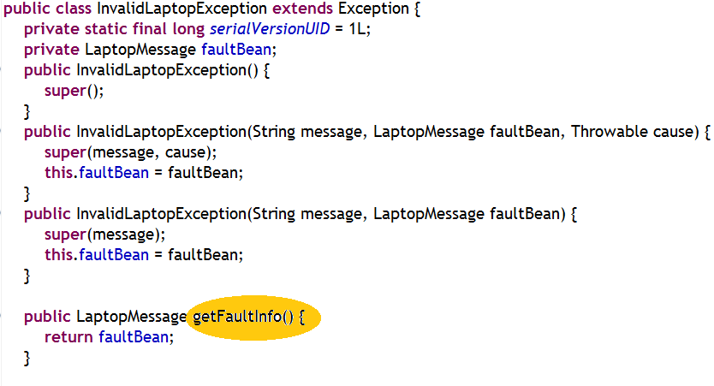

Slide 19
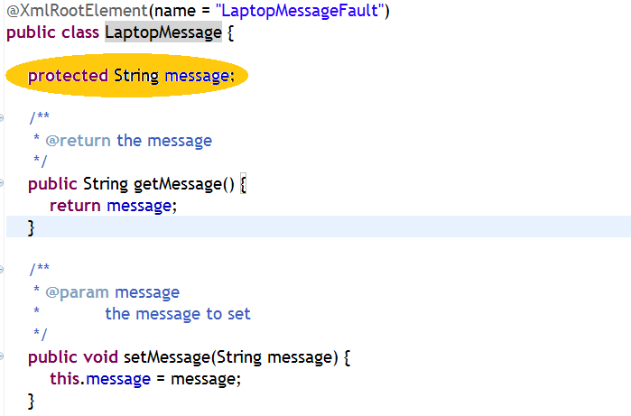

Slide 20
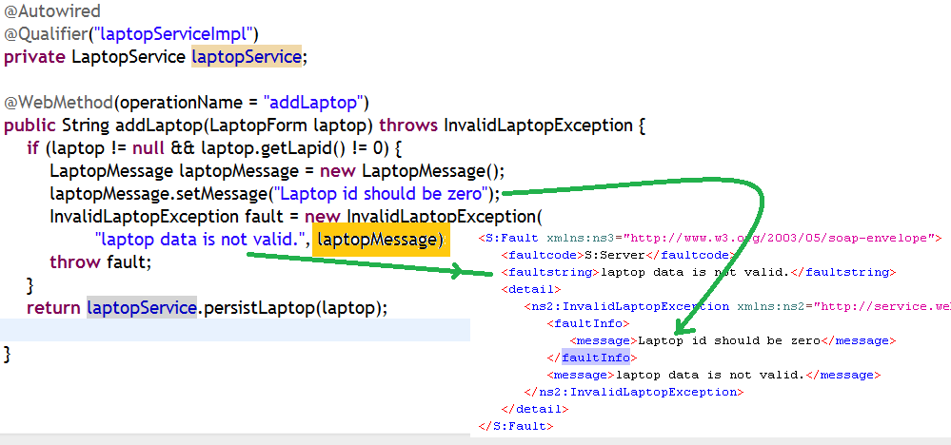

Slide 21
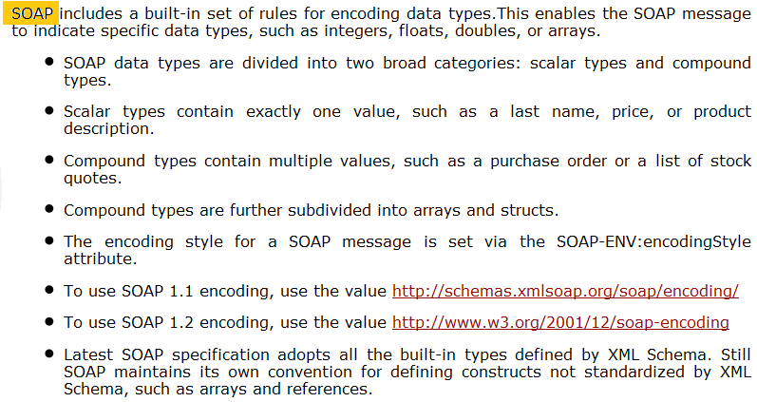
SOAP Encoding

Slide 22
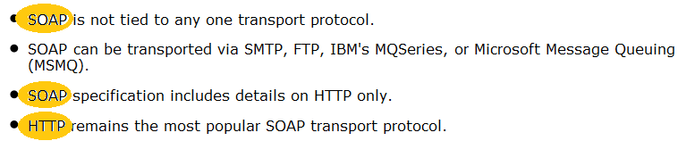
SOAP Transport

Slide 23
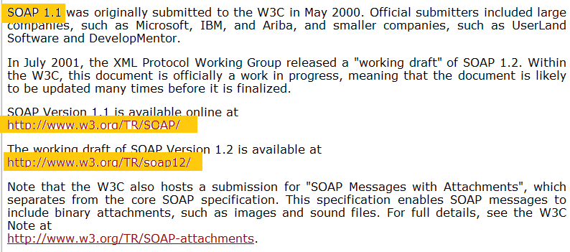
SOAP Standards

Slide 24
References
http://jax-ws.java.net/jax-ws-ea3/docs/annotations.html

